Slide 1
Hello WORLD
Your first program

Slide 2
What is A PROGRAM?
A program is a sequence of instructions that determine how to perform a computation

Slide 3
What makes up a program?
A basic program will contain the following:
Input:
External data provided by the environment or user
Output:
Data that is sent after the program has complete to the screen or outputted to a file
Math:
Computation involving addition, subtraction, multiplication, division, and other operations.
Decision:
Checks the inputs if a certain conditions are met in order to run another condition
Repetition:
An action that is repeated multiple times

Slide 4
Computer Science, what is it?
Computer Science is the study and science of algorithms
An algorithm is a sequence of step that a computer scientist uses to solve a problem
While developing these algorithms, computer scientist will come across errors, which we call bugs.

Slide 5
Your first program!(possibly)
Classically the first program that new programmers write is the “Hello, World!” program

Slide 6
Some syntax
Java uses curly braces, squiggly braces, to group items together
{}
Java also uses semicolons to end lines
;

Slide 7

Naming your program
Start by creating new file and naming it Hello_World

Slide 8
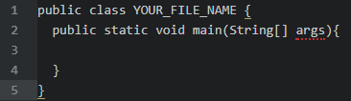
The main
You then want to create your ‘main’, a method that is our starter

Slide 9
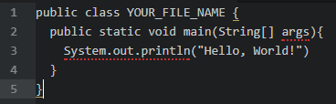
The print statement
Then print “Hello, World!”

Slide 10
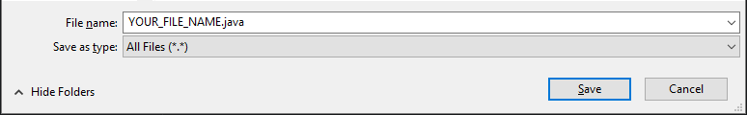
Saving
Then you want to save your file the same name you gave it during the ‘naming your program’ slide
Don’t forget the extension .java

Slide 11
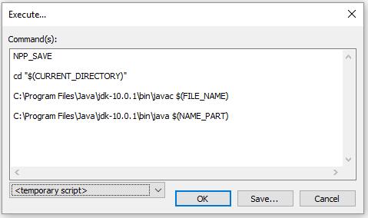
Compiling and Running
In order to run your code using npp, we need to run a script that will call the JDK to compile our source code then execute it

Slide 12
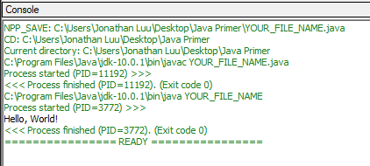
The output
Success!

Slide 13
The Breakdown…
The print statement
Case Sensitive
Method
Main
Class

Slide 14
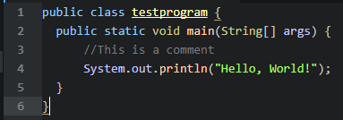
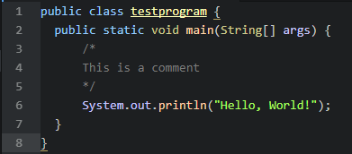
Comments?
Comments allow others looking at your code to understand what is going on
Comments are preceded by a double forward slash (//)
Block Comments (/* */)

Slide 15
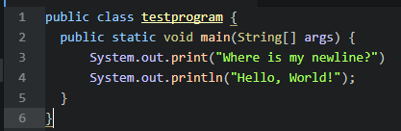
Print vs println
println or print newline appends a newline ‘escape sequence’ at the end that tells Java to go to the next line

Slide 16
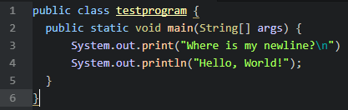
Escape Sequences
Escape sequences are a sequence of characters that represent a special characters.
Start by adding a \n to the print statement with out println. What happens?

Slide 17
Common escape sequences
\n – New Line
\t – Tab
\” – Double Quote
\\ -- Backslash

Slide 18
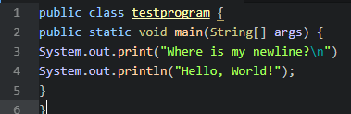
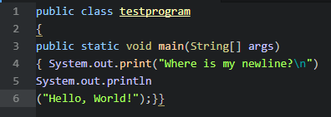
Formatting, a section on readability
Formatting our code is extremely important when reviewing as well formatted code is much easier to read and debug

